Slide 1

BMS INSTITUTE OF TECHNOLOGY & MANAGEMENT
BENGALURU
Technical Seminar On
“Performance evaluation of containers running on KUBERNETES”
DEPARTMENT OF CSE
Presented by:
Student name: Prakhyat
USN: 1BY18CS108
Dept of CSE
Under the guidance of:
Guide name: Mrs Durga Bhavani A
Designation: Asst. Professor
Dept of CSE

Slide 2
CONTENTS
CONTENTS
ABSTRACT
INTRODUCTION
METHODOLOGY
WORKING PRINCIPLE
RESULTS
CONCLUSION
REFERENCES

Slide 3
Abstract
Container-based virtualisation technologies are gaining more and more traction in recent years across Cloud platforms and this will likely continue in the coming years. As such, containers orchestration technologies are becoming indispensable. Kubernetes has become the de facto standard because of its robustness, maturity and rich features. To free users of the burden of having to configure and maintain complex Kubernetes infrastructures, but still make use of its functionalities, all major Cloud providers are now offering cloud-native managed Kubernetes alternatives. The goal of this presentation is to investigate the performance of containers running in such hosted services.

Slide 4

Introduction
Kubernetes, also known as K8s, is an open-source system for automating deployment, scaling, and management of containerized applications.
It groups containers that make up an application into logical units for easy management and discovery. Kubernetes builds upon 15 years of experience of running production workloads at Google, combined with best-of-breed ideas and practices from the community.

Slide 5

Salient Features
never outgrows
planet scale
runs K8s anywhere

Slide 6

Methodology
1.Requirement Recognition
2. Service Feature Identification
3.Metrics And Benchmark Listing
4.Metrics and Benchmark Selection
5.Experimental Factors Listing

Slide 7
6.Experimental Factors Selection
7.Experimental Design
8.Experimental Implementation
9.Experimental Analysis
10. Conclusion

Slide 8
Requirement recognition
How well can we expect containerized workloads to perform in managed Kubernetes environments
Do these services introduces any extra performance overheads compared to running a self managed Kubernetes deployments on same cloud environment
which one performs better and under what conditions
how reliable is performance while using these platforms

Slide 9
Service feature identification
measure and compare following resource features:
CPU
main memory
disk
network

Slide 10
Metrics/benchmarks listing and selection
Example:
CPU-Sysbench and Y-cruncher
Memory-STREAM
Disk- Sysbench and Bonnie++
Network-Nuttcp and Netperf

Slide 11
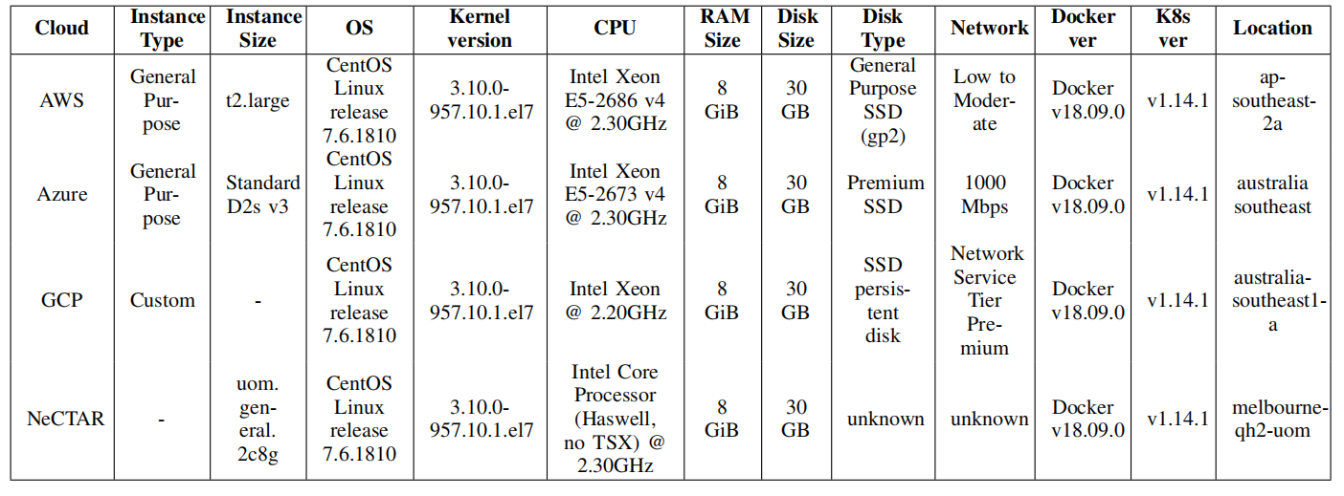
Experimental factors listing and selection
Characteristics of Baseline

Slide 12
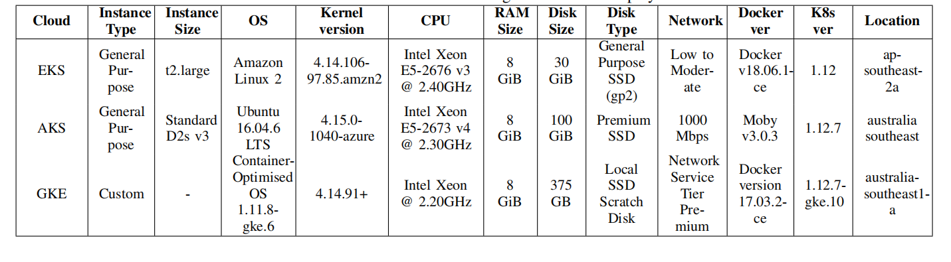
characteristics of managed kubernetes deployment

Slide 13
Experimental design

Slide 14
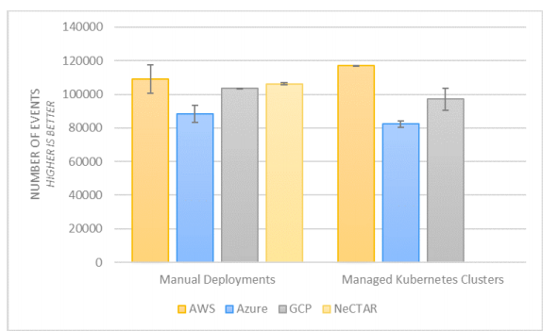
Results
computing performance results using Sysbench

Slide 15
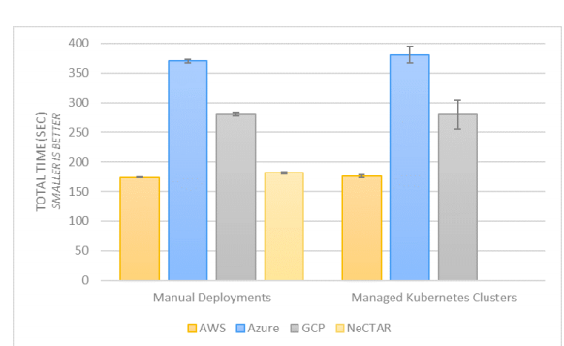
computing performance results using Y-cruncher

Slide 16
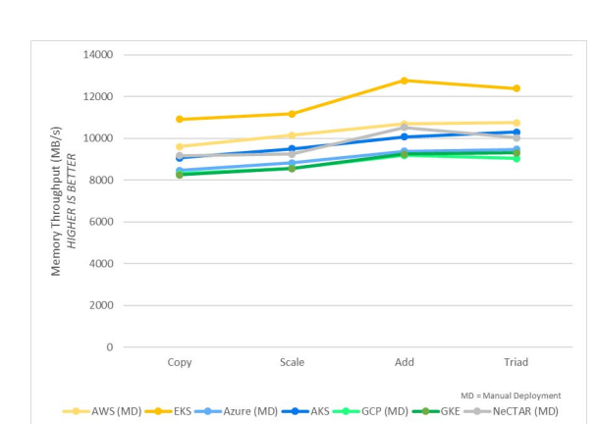
Memory performance results using STREAM

Slide 17
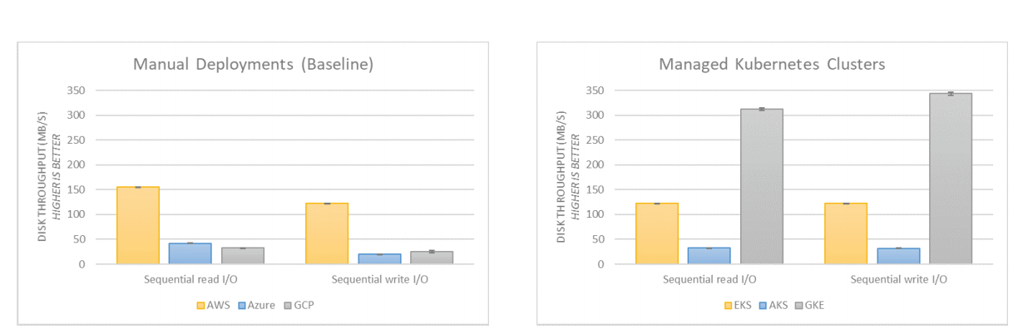
disc benchmark results using Bonnie++

Slide 18
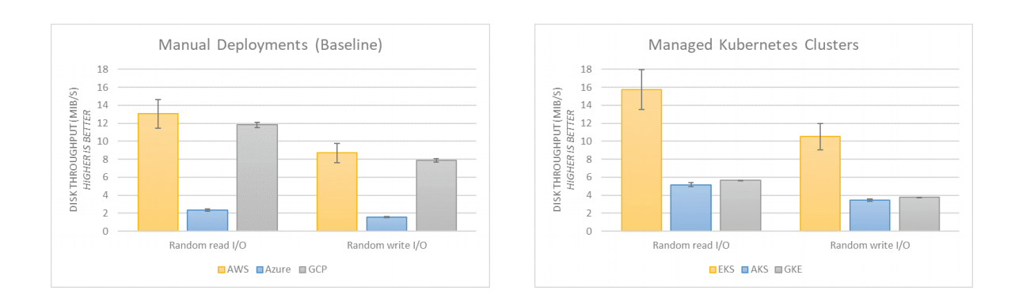
Disk management results by sysbench

Slide 19
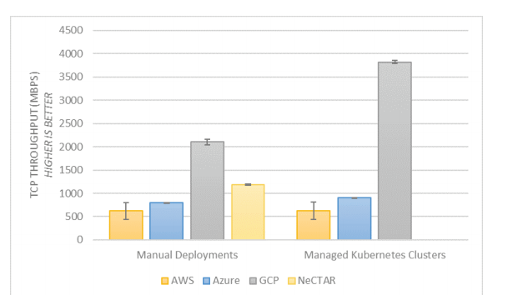
network throughput performance results using Nuttcp

Slide 20
Conclusion
performance mainly depends on the underlying resources

Slide 21
REFERENCES
[1] G. Research, Hype cycle for cloud computing, 2018, https:// www. gartner.com/en/documents/3884671, [Online; accessed 11-June-2019], 2018.
[2] R. Hat, Red hat global customer tech outlook 2019: Automation, cloud, security lead funding priorities, https://www.redhat.com/en/blog/red hat- global- customer-tech- outlook- 2019- automation- cloud- security lead-funding-priorities?source=bloglisting, [Online; accessed 11-June-2019], Dec. 2018.
[3] Diamanti, 2018 container adoption benchmark survey, https://diamanti. com/wp- content/uploads/2018/07/WP Diamanti End- User Survey 072818.pdf, [Online; accessed 11-June-2019], 2018.
[4] Portworx, 2018 container adoption survey, https://portworx.com/wp content / uploads / 2018 / 12 / Portworx - Container - Adoption - Survey -Report-2018.pdf, [Online; accessed 11-June-2019], 2018.
[5] S. Soltesz, H. Potzl, M. E. Fiuczynski, A. Bavier, and L. Peterson,“Container-based operating system virtualization: A scalable, high performance alternative to hypervisors,” in ACM SIGOPS Operating Systems Review, ACM, vol. 41, 2007, pp. 275–287.
[6] R. Morabito, J. Kj¨allman, and M. Komu, “Hypervisors vs. lightweight virtualization: A performance comparison,” in 2015 IEEE International Conference on Cloud Engineering, IEEE, 2015, pp. 386–393.
[7] W. Felter, A. Ferreira, R. Rajamony, and J. Rubio, “An updated performance comparison of virtual machines and linux containers,” in 2015 IEEE international symposium on performance analysis of
systems and software (ISPASS), IEEE, 2015, pp. 171–172.
[8] R. Dua, A. R. Raja, and D. Kakadia, “Virtualization vs containerization to support paas,” in 2014 IEEE International Conference on Cloud Engineering, IEEE, 2014, pp. 610–614.
[9] A. M. Joy, “Performance comparison between linux containers and virtual machines,” in 2015 International Conference on Advances in Computer Engineering and Applications, IEEE, 2015, pp. 342–346.
[10] Kubernetes, Production-grade container orchestration, https : / /kubernetes.io/, [Online; accessed 11-June-2019].

Slide 22
THANK YOU

